Slide 1

Testing
Components
Using
bUnit
Daniel Villamizar
Senior Cloud Solutions Architect - MVP
@danielvillamizara – https://www.linkedin.com/in/danielvillamizara/

Slide 2


Module
overview
Understanding unit tests
Writing tests with bUnit

Slide 3
Understanding
Unit
Tests

Slide 4
A
unit
test is
an
automated piece
of
code
the
that
invokes a
unit
of
work
in
system
and
then
checks
a
single
assumption
about
the
behavior
of
that
unit
of
work.
From The Art of Unit Testing, Roy Osherove

Slide 5
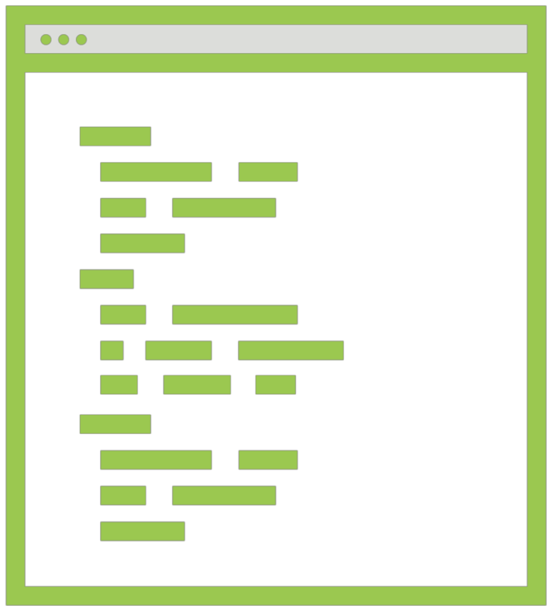
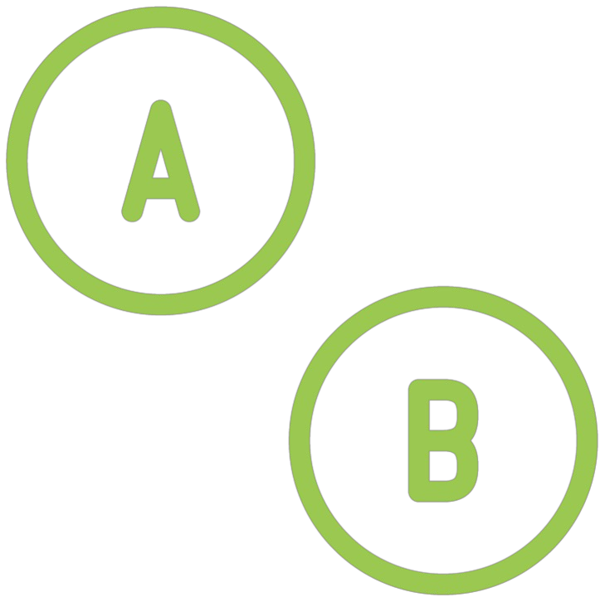

Unit
Tests
Block of code
Public methods
Isolated and
independent

Slide 6
Using
Unit
Tests
Consistent
Automated
Fast

Slide 7



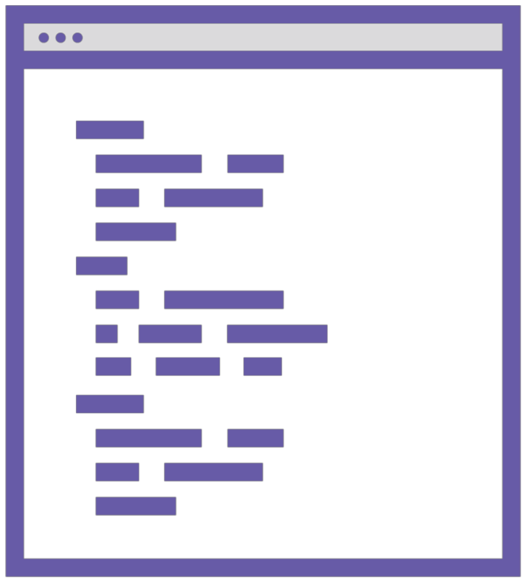
Why
Do
We
Need
Unit
Tests?
Find bugs
Change
without
Improve quality
Documentation
of code
fear of breaking
something

Slide 8

Parts of a unit test
-
-
-
Arrange
Act
Assert
Commonly used frameworks
-
-
xUnit, Nunit, MSTest
Moq

Slide 9
A
Simple
Unit
Test
public
void
CanUpdatePiePrice()
{
// Arrange
var pie =
new Pie { Name = "Sample pie", Price = 12.95M };
// Act
pie.Price = 20M;
//Assert
Assert.Equal(20M, pie.Price);
}

Slide 10
Writing
Tests
with
bUnit

Slide 11

Introducing bUnit
Unit testing library for Blazor components
Relies on xUnit (or other) unit
framework
testing
Not a UI testing library!

Slide 12
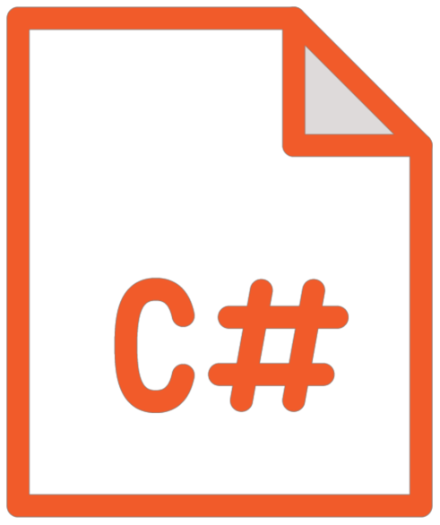


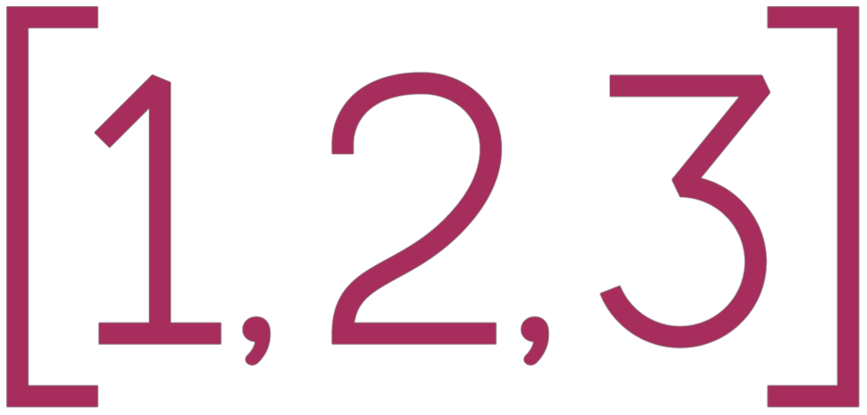
Features
of
bUnit
Testing using C# or Razor files
Semantic HTML
comparer
Interacting with
components
and
triggering
events
Passing parameters and injecting
services

Slide 13
Creating
a
bUnit
Project
bUnit Template
Manual

Slide 14


Demo
Creating the test project in the solution

Slide 15
Writing
Tests
*.cs files
*.razor files

Slide 16

<h1>Hello Pluralsight</h1>
Sample Component to Test
Component name: HelloPluralsight.razor

Slide 17
bUnit
Testing
Code
@code
{
[Fact]
public
{
void
HelloWorldComponentRendersCorrectly()
//Arrange
using
var
ctx
=
new
TestContext();
//Act
var
cut
=
ctx.Render(@<HelloPluralsight
/>);
//Assert
cut.MarkupMatches(@<h1>Hello
Pluralsight</h1>);
}
}

Slide 18
Demo
Testing our components

Slide 19
More
Advanced
Testing
Scenarios
Event handlers
IJSRuntime emulation
Faking authorization
Mocked HttpClient

Slide 20
Demo
Testing components with injected services

Slide 21
Summary
bUnit offers a simple but powerful way to
test components
Razor-based tests offer the easiest approach

Slide 22
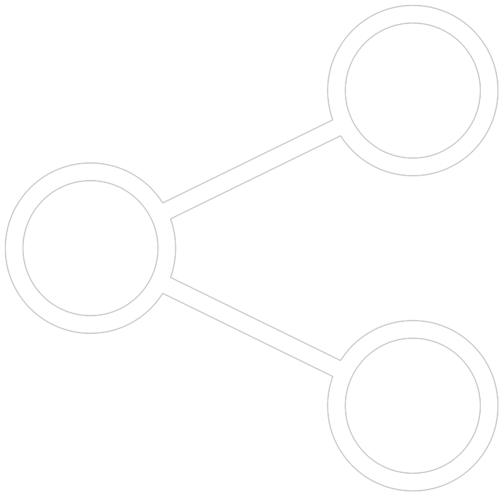
Up
next:
Sharing
code
between
Blazor
client
and
server

